Slide 1

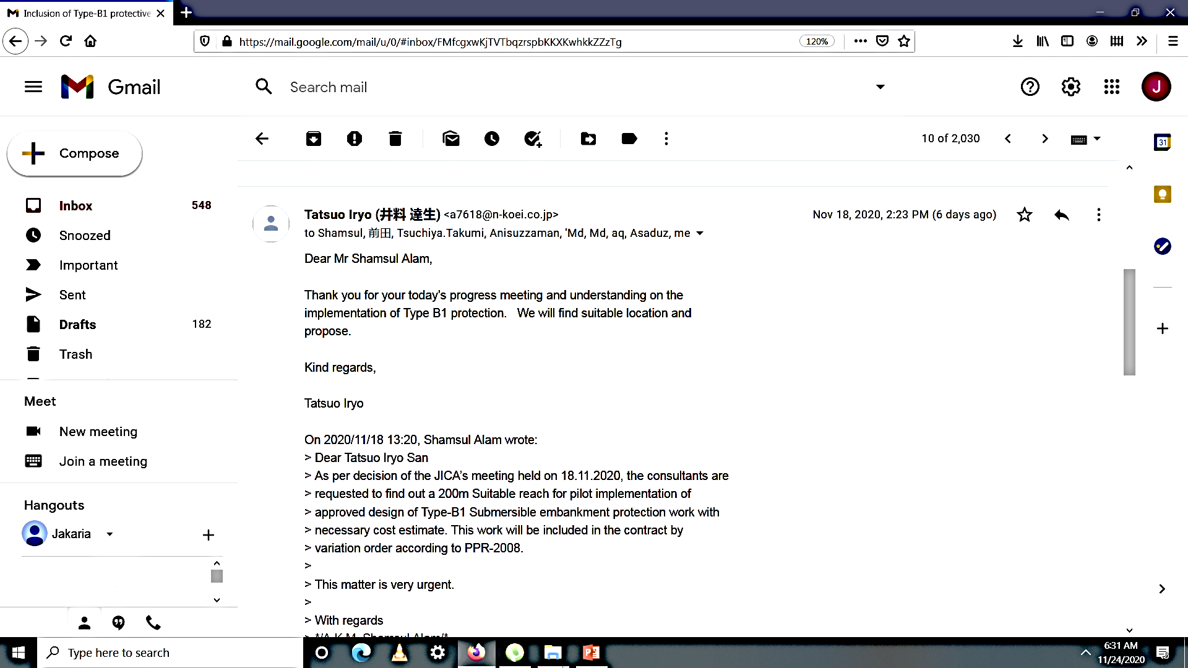
JICA’S APPRECIATION

Slide 2
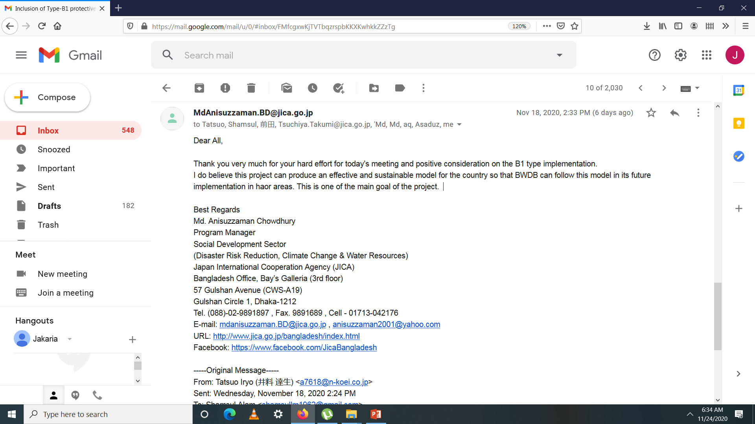
JICA’S APPRECIATION

Slide 3
WHY DID WE GET APPRECIATION

Slide 4
WHY DID WE GET APPRECIATION
For Accurate Representation of Flood Situation in the project area(Damage)
For Representation and Explaining in detail of Design of different type of protection work.
For Presentation of Activity plan for civil works next two dry seasons
Progress in agriculture component and plan for next FY
Presentations of civil works monitoring format

Slide 5
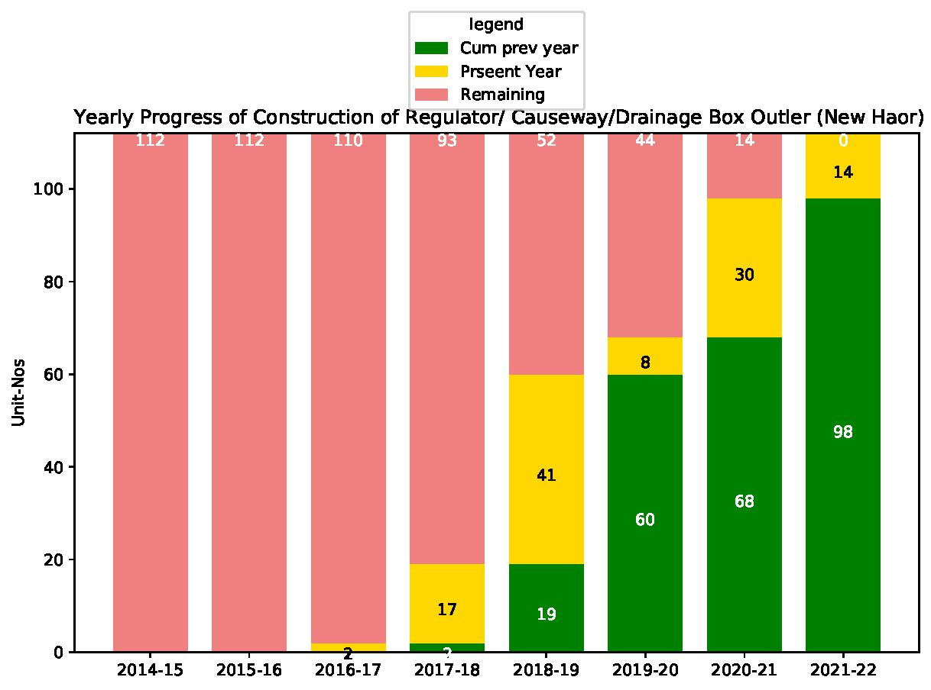
Activity Plan for Next TWO Years?

Slide 6
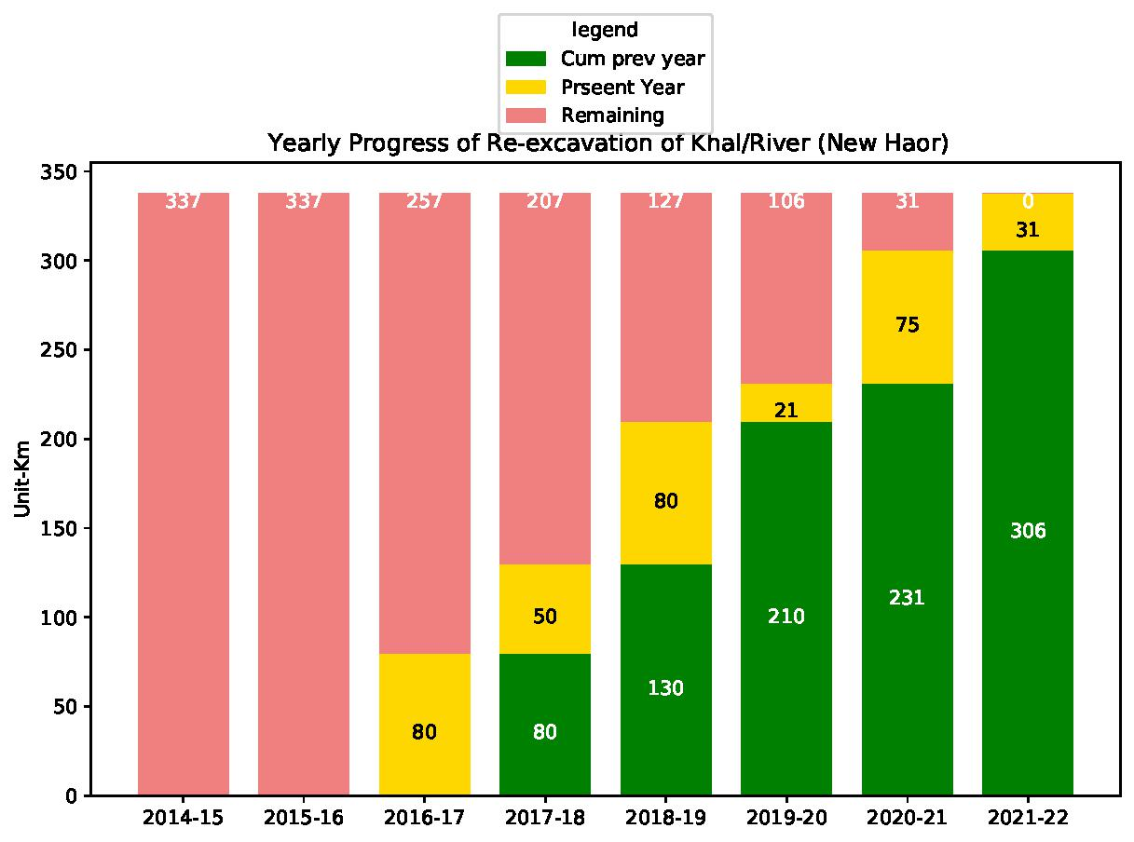
Progress of Re-excavation of Khal/River (New Haor)

Slide 7
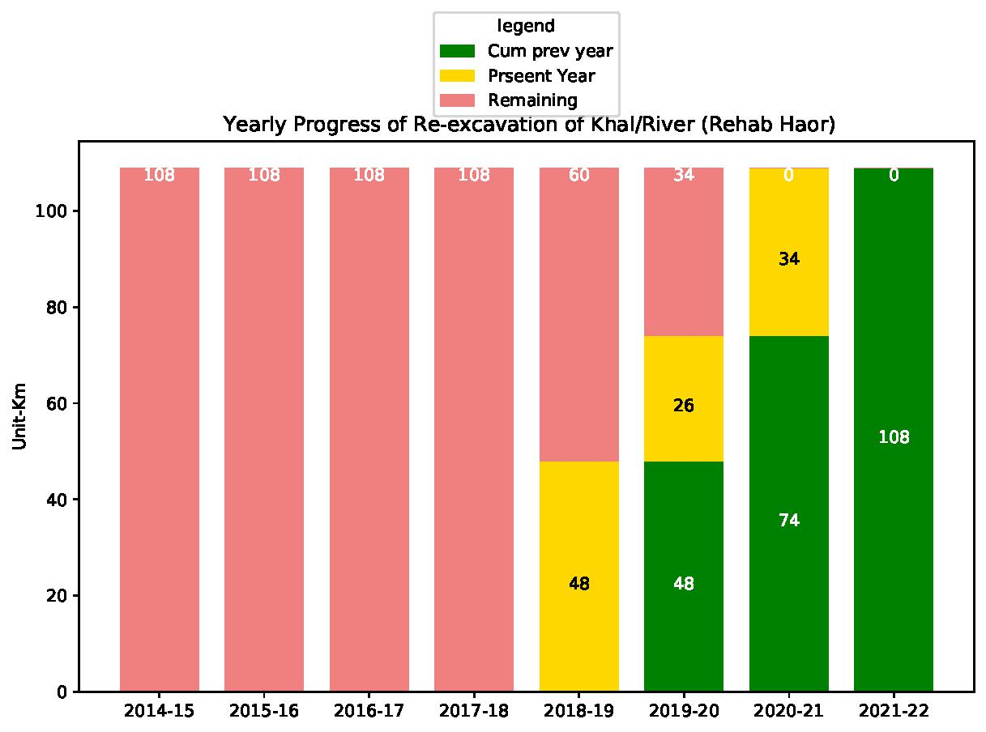
?
Progress of Re-excavation of Khal/River (Rehab Haor)

Slide 9
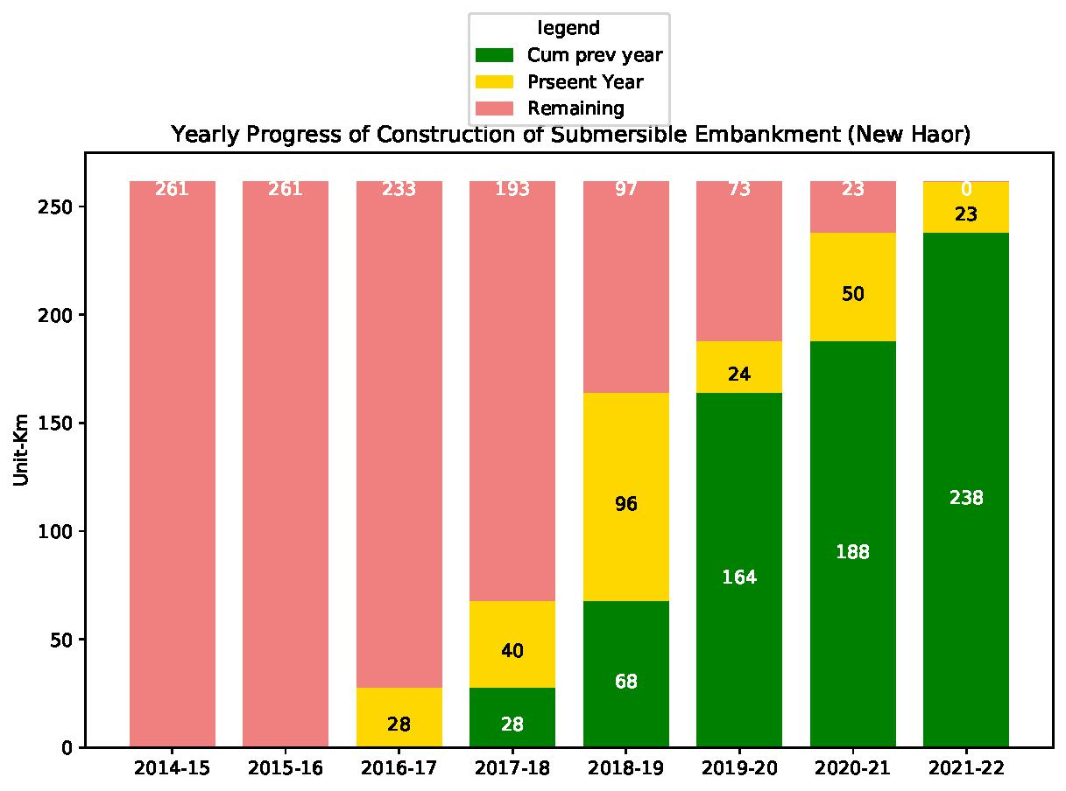
Progress of Construction of Submersible Embankment (New Haor)

Slide 10
Activity Plan for Next TWO Years?

Slide 11
Activity Plan for Next TWO Years?

Slide 12
Progress of Re-excavation of Khal/River (Rehab Haor)

Slide 14
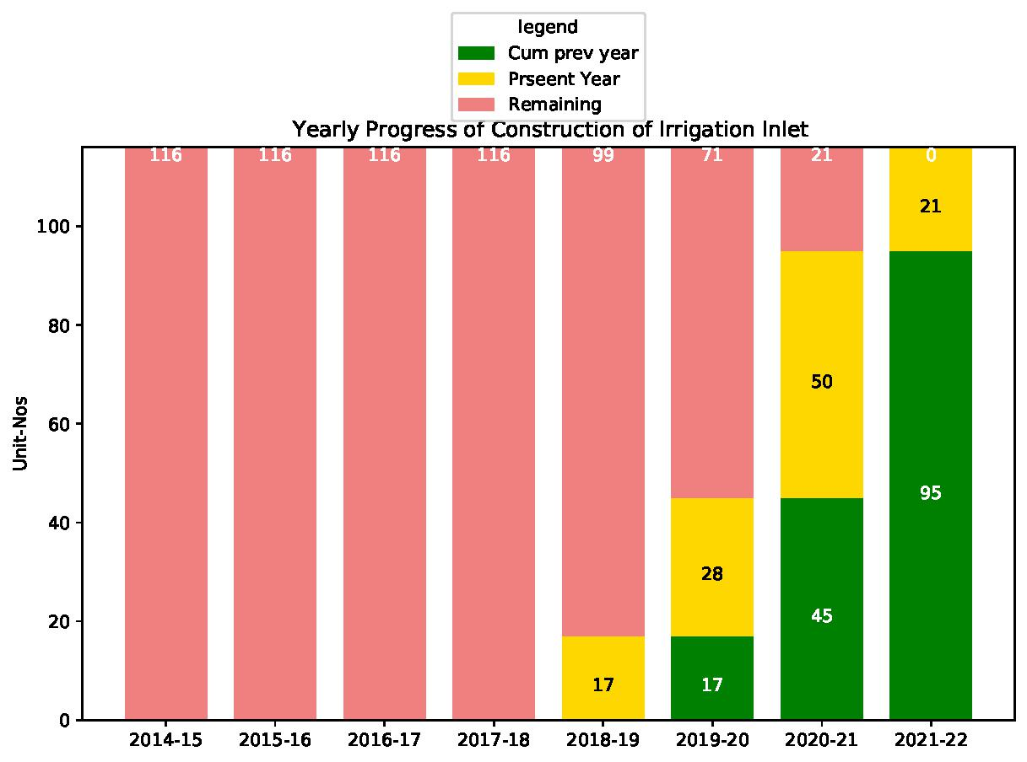
Progress of Irrigation Inlet

Slide 15
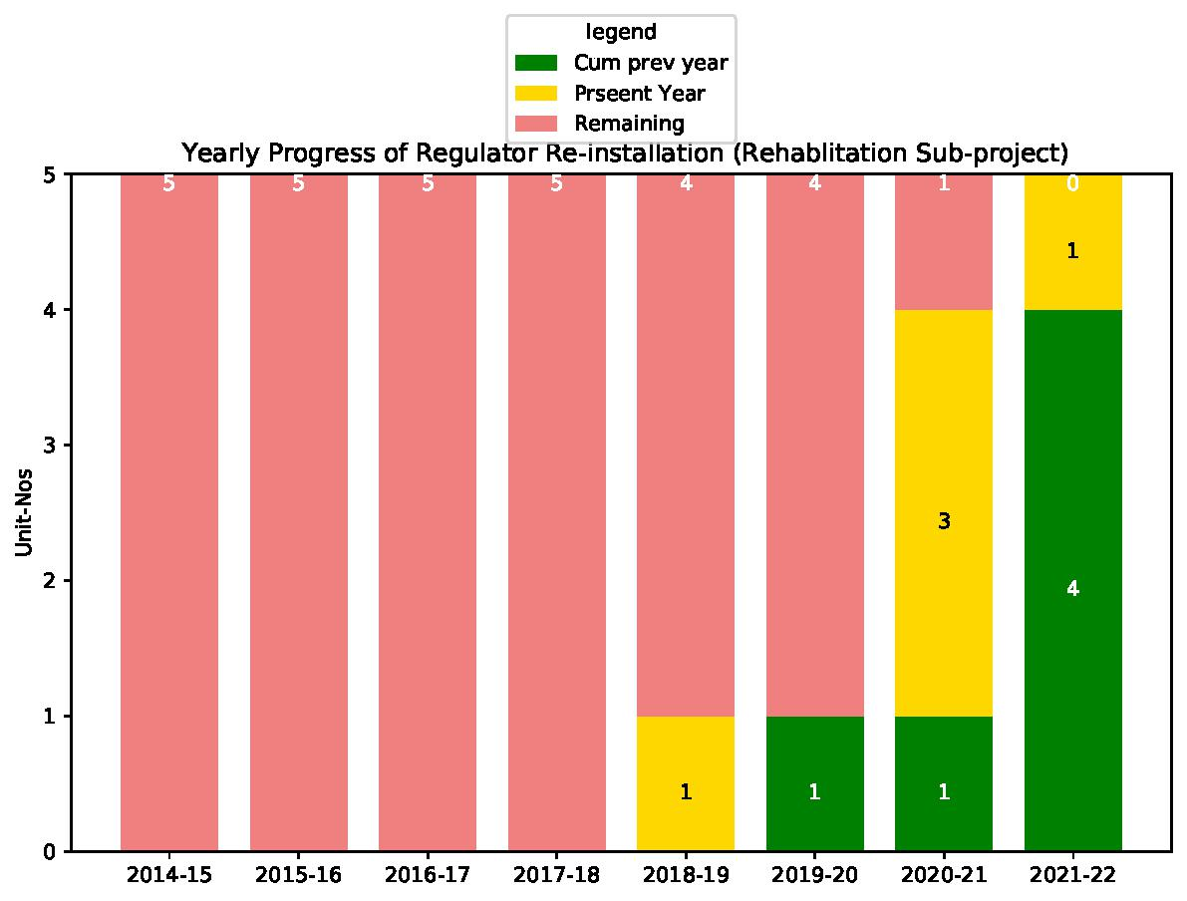
Progress of Reinstallation of Regulator (Rehab-Haor)

Slide 16
Progress of Construction of Regulator/Causeway/Box Drainage Outlet

Slide 17
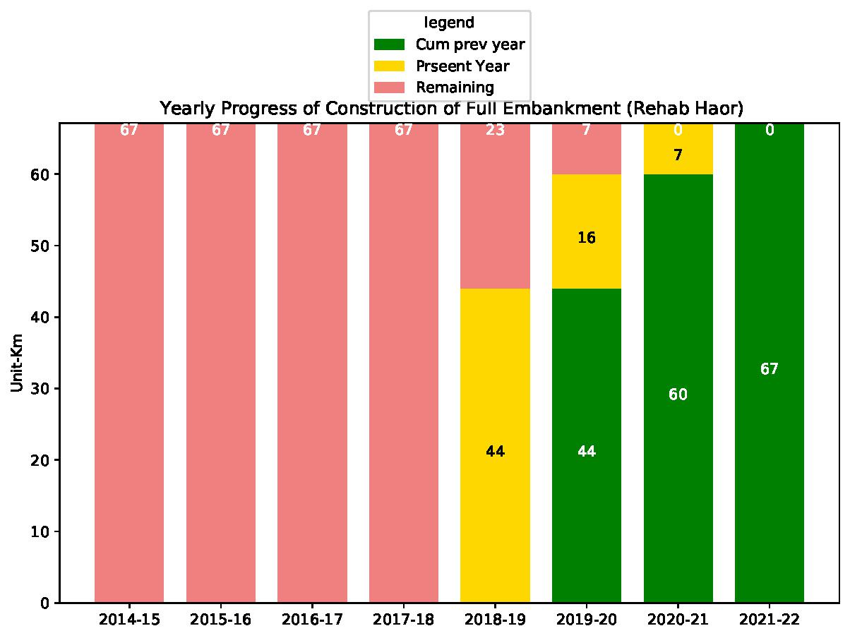
Progress of Repair of Full Embankment (Rehab Haor)

Slide 18
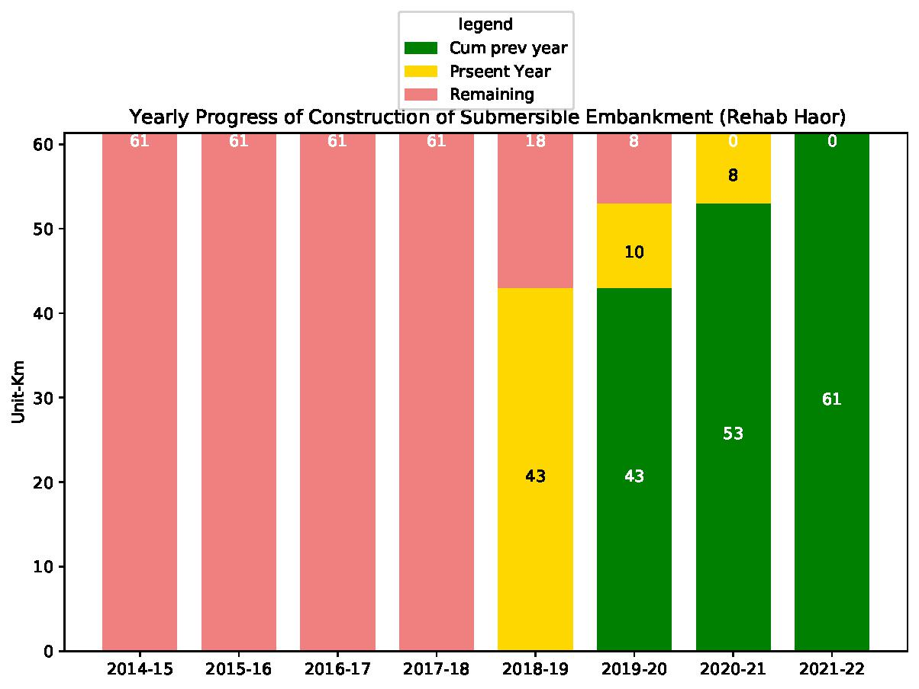
Progress of Rehab of Submersible Embankment (Rehab Haor)

Slide 19
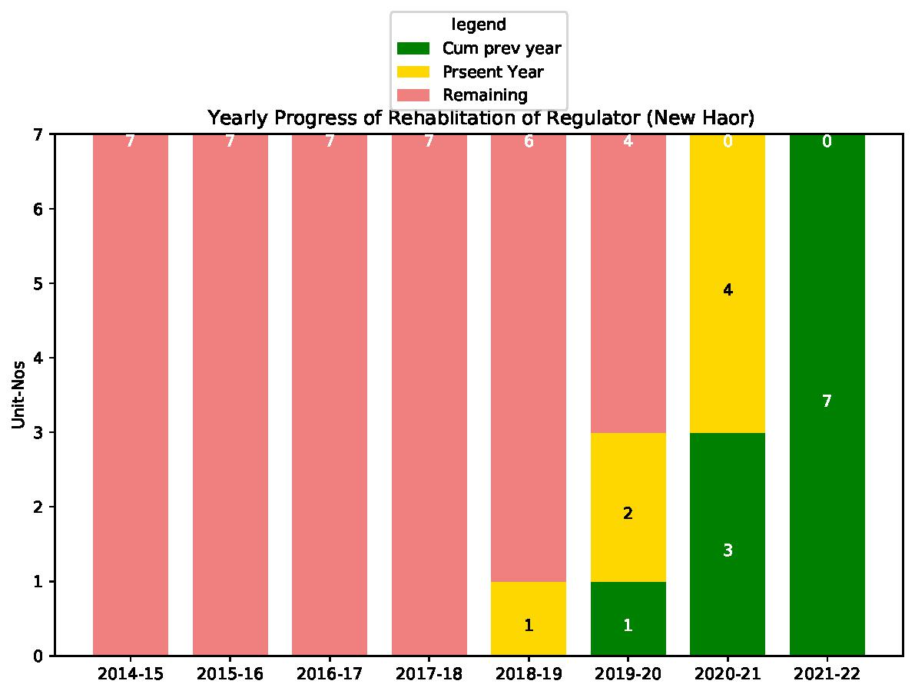
Progress of Rehabilitation of Regulator(New Haor)

Slide 20
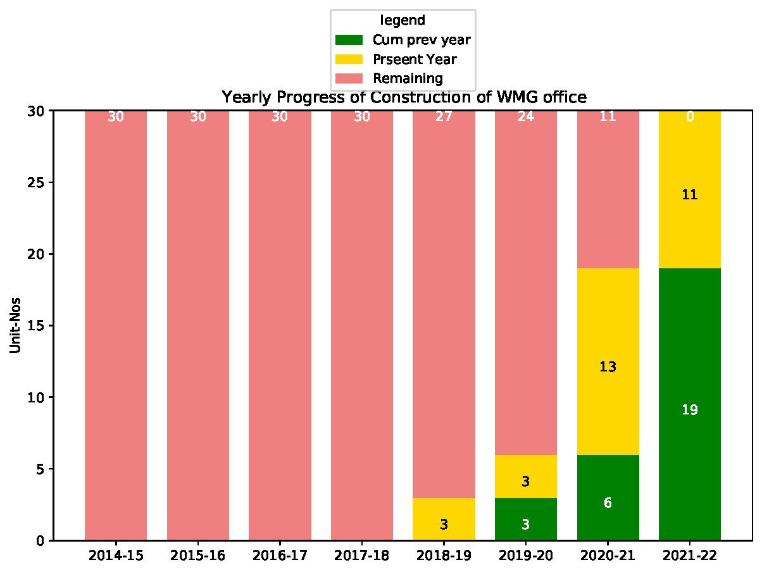
Progress of Construction of WMG Office

Slide 21
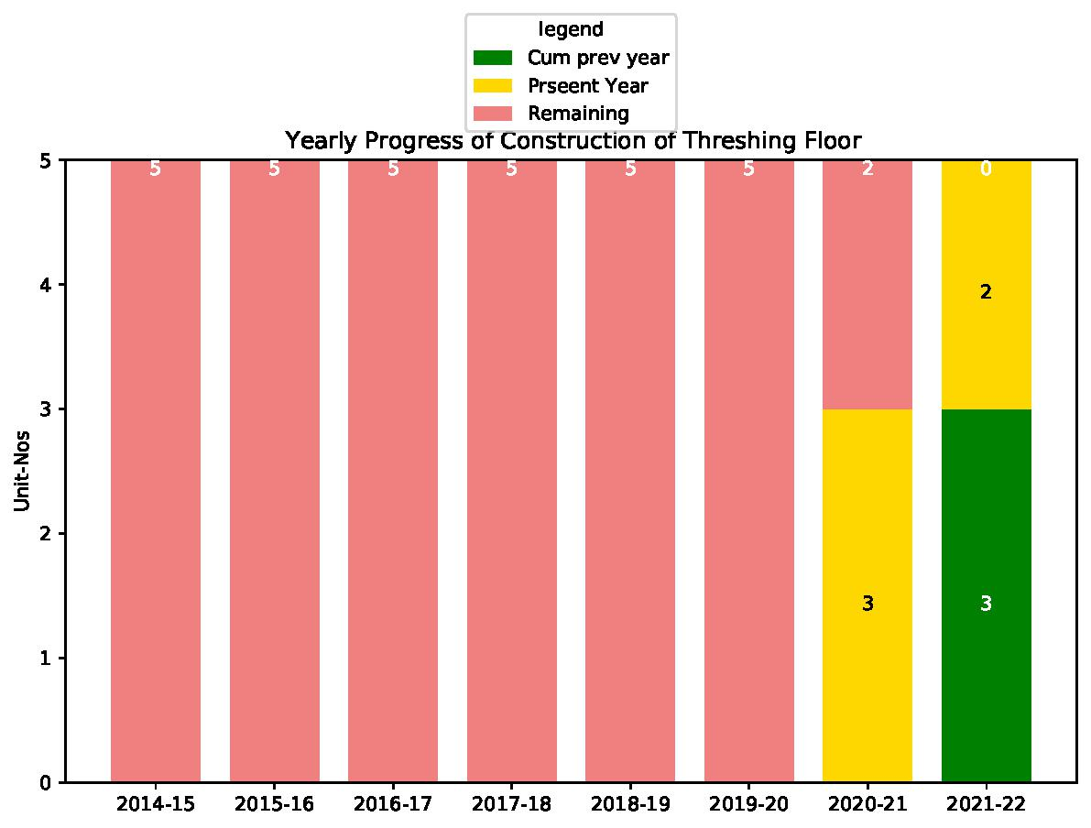
Progress of Construction of Threshing Floor

Slide 22
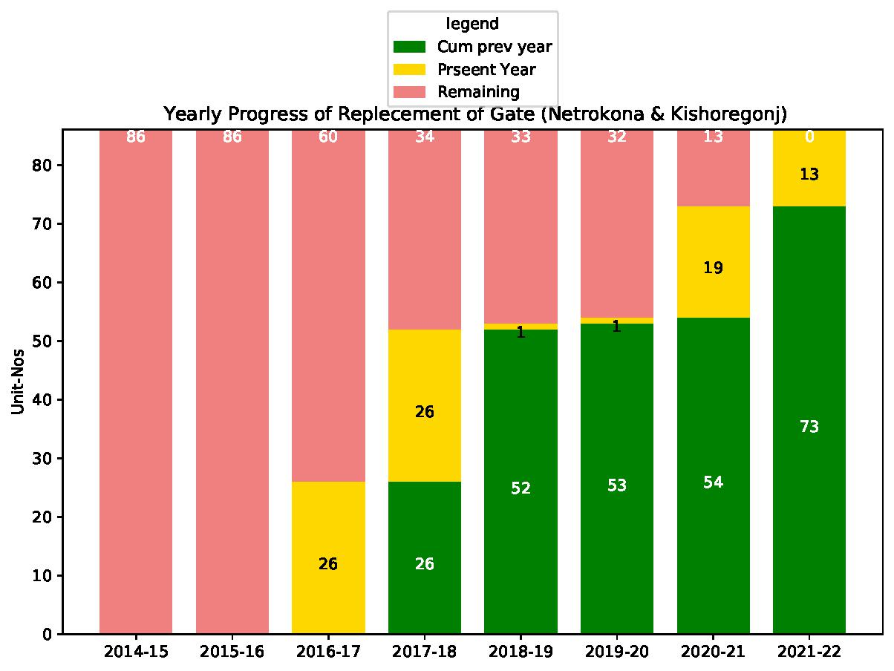
Progress of Replacement of Regulator Gates

